Slide 1

PRIMS AND KRUSKALS ALGORITHM
Name:-Ayush Shah K
Roll no. :- 222
Enrolment no.:- 21002170110167
Batch :- S8
Branch :- CE

Slide 2
INTRODUCTION
Prim’s and Kruskal’s algorithm is a minimum spanning tree algorithm that takes a graph in form of matrix as input and finds the subset of the edges of that graph.
Form a tree that includes every vertex.
Has the minimum sum of weights among all the trees that can be formed from the graph.

Slide 3
IMPLEMENTATION
PRIM’S:
Initialize the minimum spanning tree with a vertex chosen at random.
Find all the edges that connect the tree to new vertices, find the minimum and add it to the tree.
Keep repeating step 2 until we get a minimum spanning tree.
KRUSKAL’S
Sort all the edges from low weight to high.
Take the edge with the lowest weight and add it to the spanning tree. If adding the edge created a cycle, then reject this edge.
Keep adding edges until we reach all vertices.

Slide 4
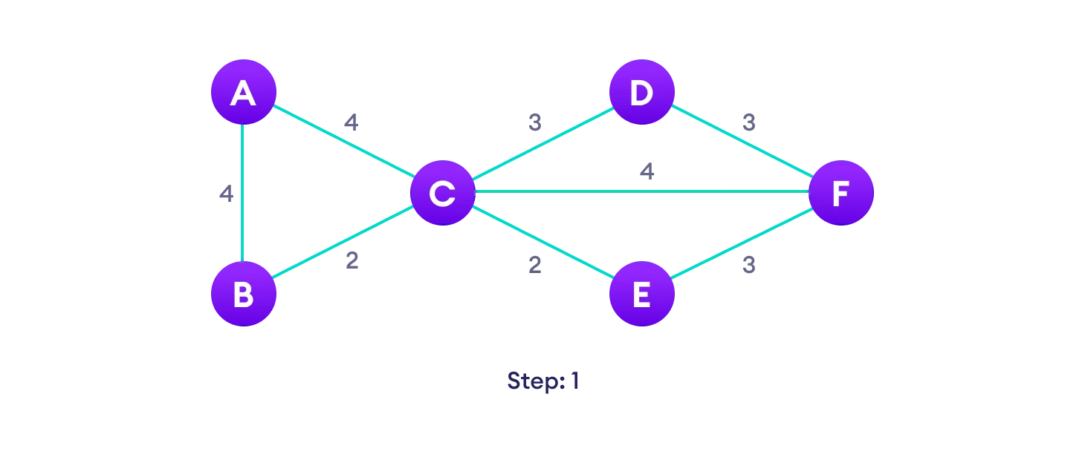


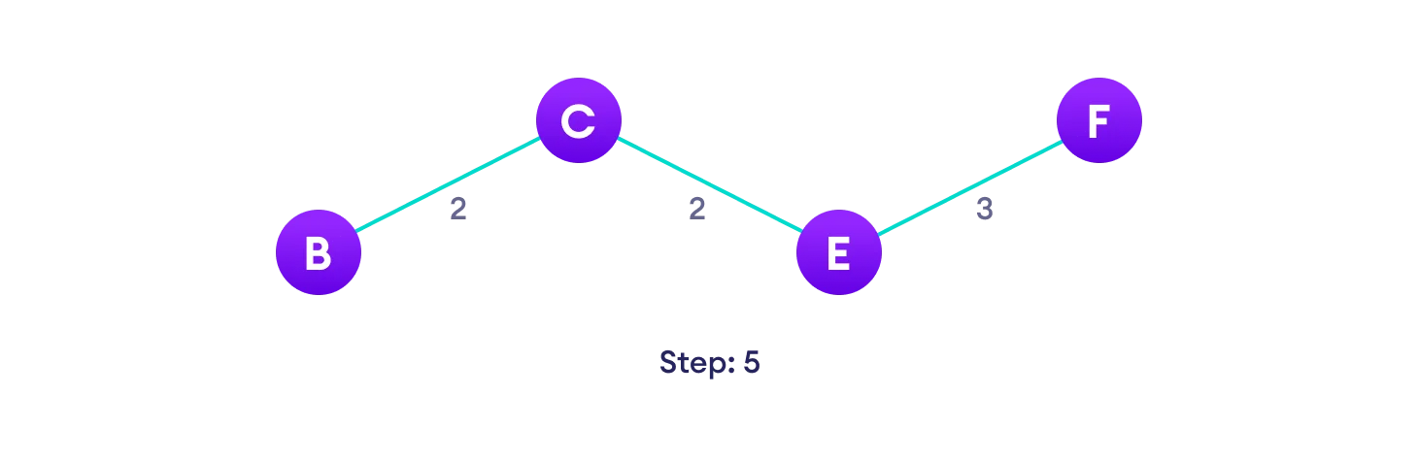

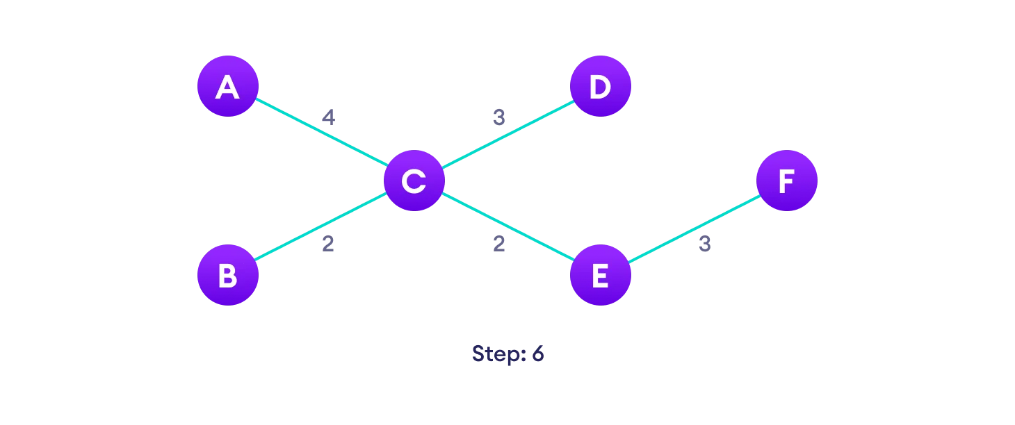
TAKING EXAMPLE TO SEE HOW PRIM’S WORKS

Slide 5
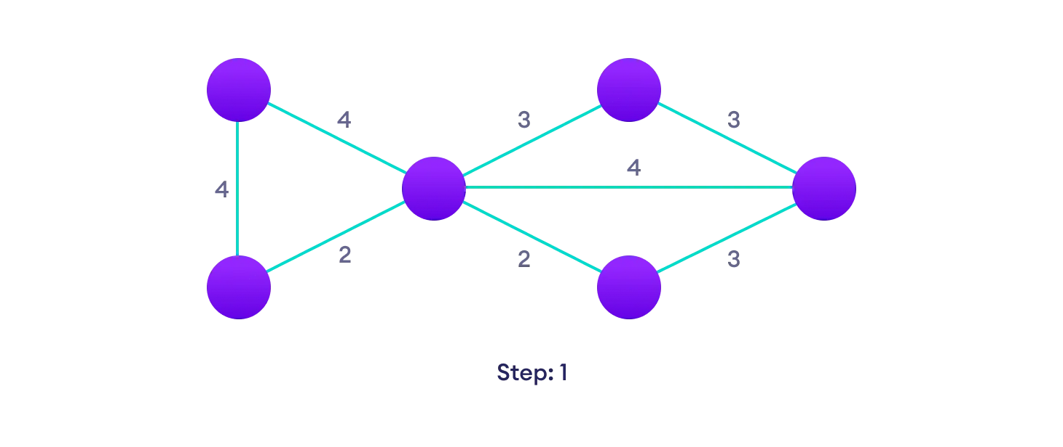


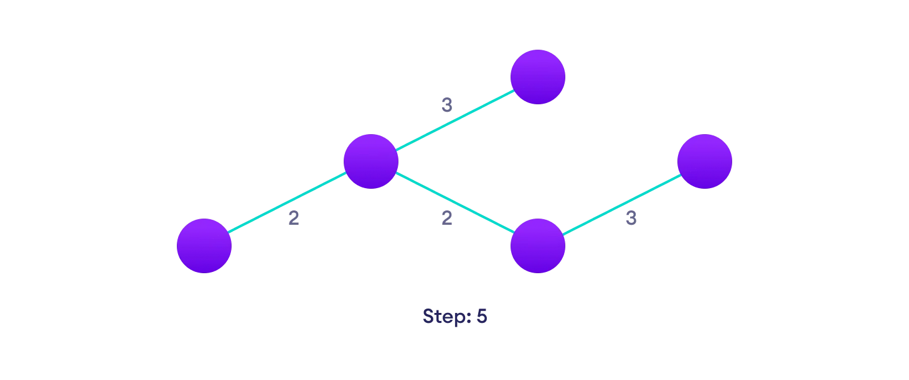
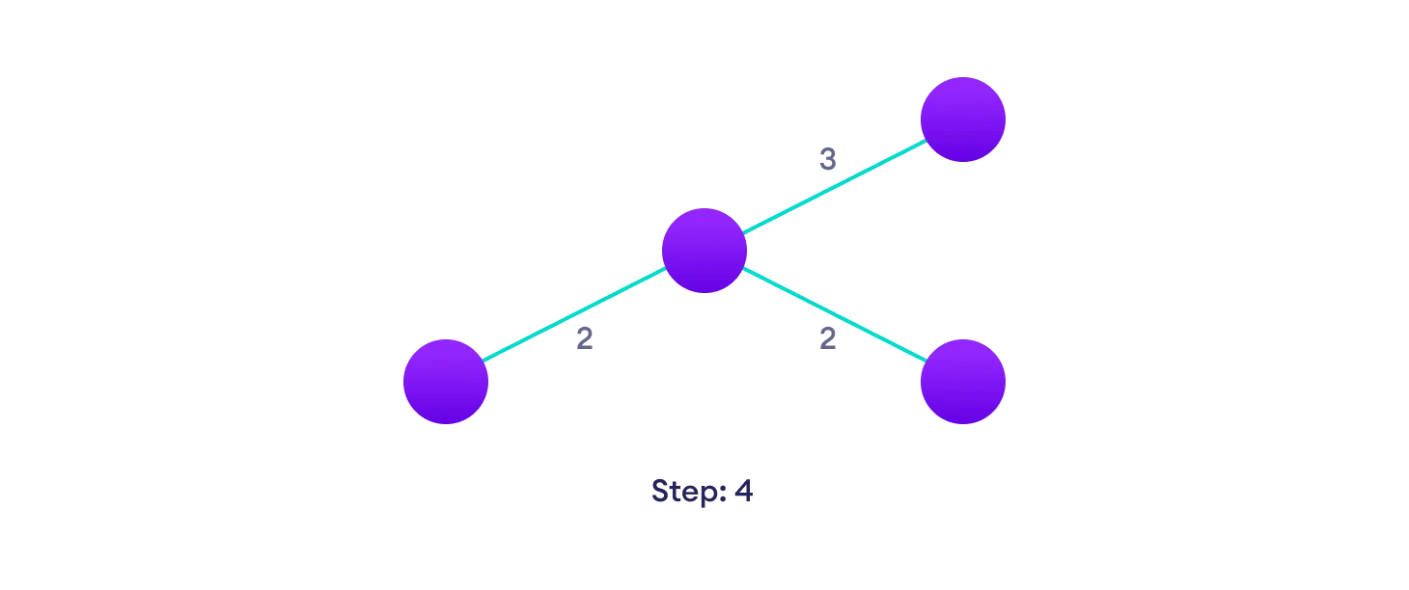
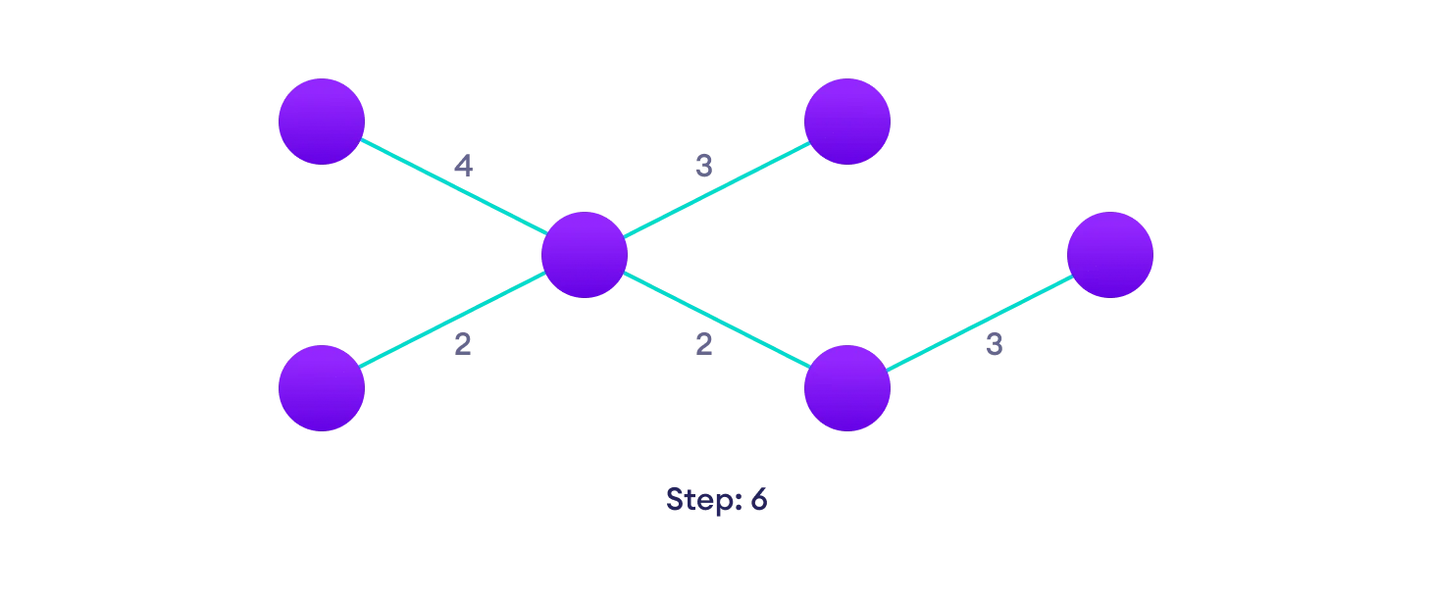
TAKING EXAMPLE TO SEE HOW KRUSKAL’S WORKS

Slide 6
DIFFERENCE BETWEEN
PRIM’S
KRUSKAL’S
It starts to build the Minimum Spanning Tree from any vertex in the graph.
It traverses one node more than one time to get the minimum distance.
Has a time complexity of O(V²).
It gives connected component as well as it works only on connected graph.
Runs faster in dense graphs.
Applications :Travelling Salesman Problem, Network for roads and Rail tracks connecting all the cities etc.
Prefer list data structures.
It generates the minimum spanning tree starting from the root vertex.
It starts to build the Minimum Spanning Tree from the vertex carrying minimum weight in the graph.
It traverses one node only once.
Has time complexity is O(E log V)
It generate forest(disconnected components) at any instant as well as it can work on disconnected components
Runs faster in sparse graphs.
Applications :LAN connection, TV Network etc.
Prefer heap data structures.
It generates the minimum spanning tree starting from the least weighted edge.

Slide 7
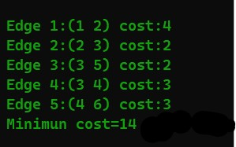
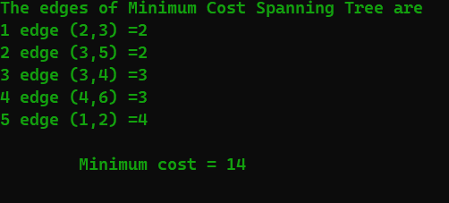
INPUT:
OUTPUTS:
PRIM’S
In input we need to add adjacent matrix.
So the adjacent matrix in corresponding above example is:
1 2 3 4 5 6
1 0 4 4 0 0 0
2 4 0 2 0 0 0
3 4 2 0 3 2 4
4 0 0 3 0 0 0
5 0 0 2 0 0 3
6 0 0 4 3 3 0
KRUSKAL’S

Slide 8
THANK-YOU!

